Slide 1
Southeastern Client
Suzanne Smethers
Inteprod LLC
Eagleville, PA

Slide 2
Inteprod
Founded in 2004
Medical Product development
Contract Manufacturing
Life saving and life changing products
Supplier to worldwide Medical Manufactures
Clean room production
18 employees

Slide 3
Inteprod Story

Slide 4
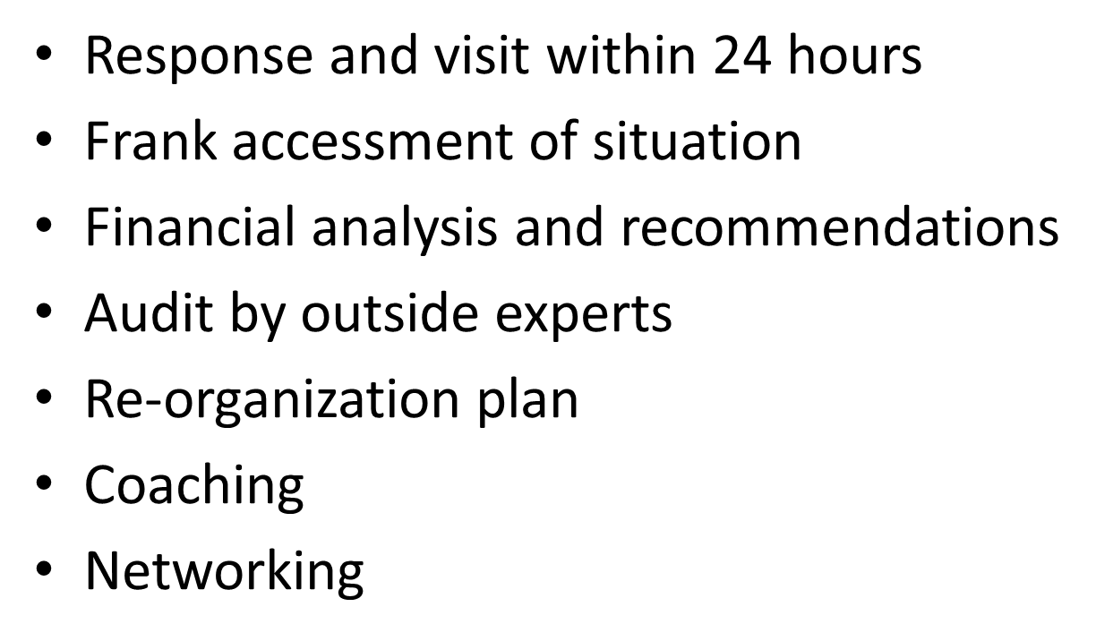
Call To Sewn

Slide 5
Results

Slide 6
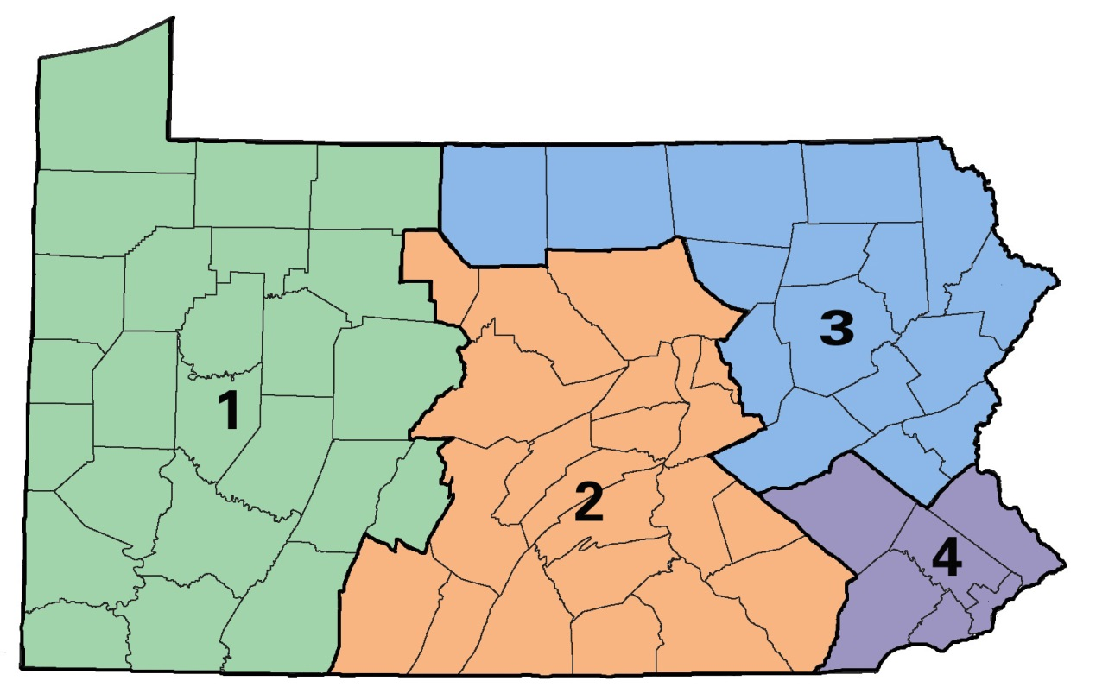
SEWN Office Locations
1. Western PA SEWN Office
c/o Steel Valley Authority
1112 South Braddock Ave.
Suite 300
Swissvale, PA 15218
412-342-0534 (Phone)
412-342-0538 (Fax)
1-866-782-8832 (Toll Free)
sewn@steelvalley.org
2. Central PA SEWN Office
c/o Capital Office
301 Chestnut Street
Suite 103
Harrisburg, PA 17101
717-901-6030 (Phone)
717-901-6033 (Fax)
sewncentral@steelvalley.org
3. Northeast PA SEWN Office
Phoenix Plaza
22 E. Union Ave., Suite 200
Wilkes Barre, PA 18701
570-829-7850 (Phone)
570-829-7852 (Fax)
sewnne@steelvalley.org
4. Southeast PA SEWN Office
c/o Bucks County WIB
1268 Veterans Highway
Bristol, PA 19007
215-458-7580 (Phone)
215-874-2804 (Fax)
sewnse@steelvalley.org

